Slide 1



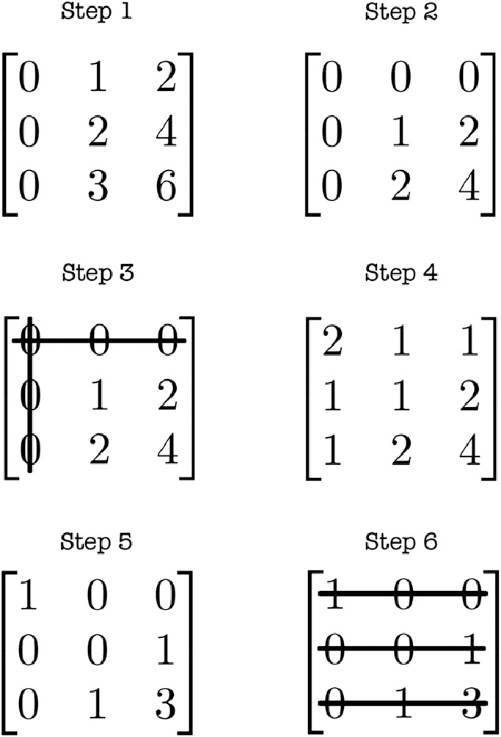
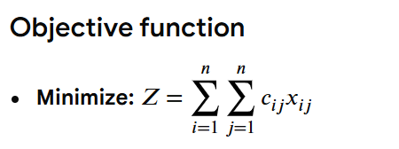


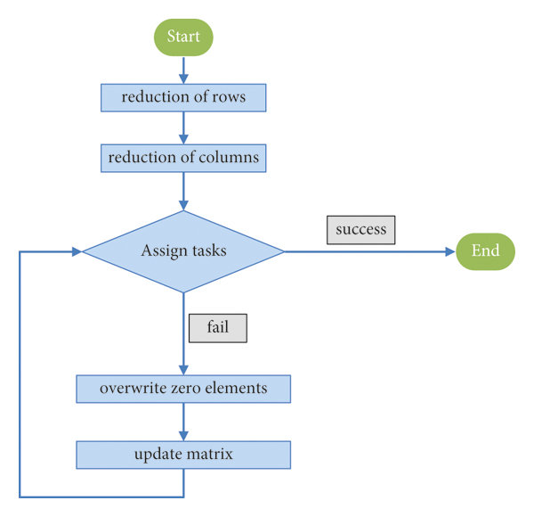
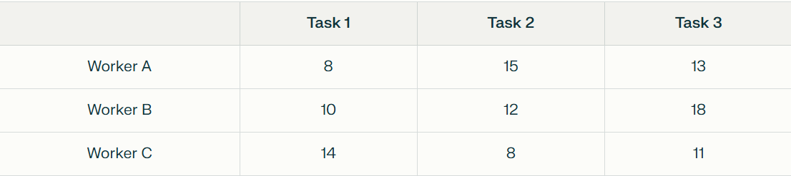
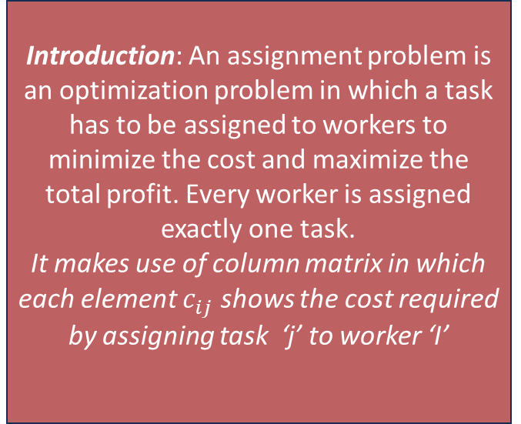

K. J. Somaiya school of Engineering, Mumbai – 400 077
Department of Science and Humanities
F.Y. B. Tech. Semester –I (2025-26)
Applied Mathematics-I
Name: Veer Rathod
Roll No: 16010125208
Div: C, Batch: 3
Application of Matrices in Assignment Problem
Introduction: An assignment problem is an optimization problem in which a task has to be assigned to workers to minimize the cost and maximize the total profit. Every worker is assigned exactly one task.
It makes use of column matrix in which each element $c_{ij}$ shows the cost required by assigning task ‘j’ to worker ‘I’
Hungarian algorithm:
Real Life Applications:
Job scheduling: giving projects to employees to minimize cost & maximize productivity
Transportation & logistics: Assigning delivery routes to trucks to reduce fuel usage.
Education: assigning specific teachers to students to improve the mentors
Airline crew assignment: minimizing the crew idle time with the help of proper shift allocation.
Resource management in hospitals: assigning doctors or nurses to specific department to improve the efficiency
Constraints:
$$x_{ij} should be either 1 or 0$$
Example:
Objective: Each worker should be assigned one task such that the total cost is minimum
Using the Hungarian algorithm given below we get the result for the minimum cost as follows:
A→ Task1
B→ Task 2
C → Task 3
Row Reduction
Column Reduction
Cover Zeros
Adjust Matrix
Make Assignment's
References:
https://onlinelibrary.wiley.com/doi/abs/10.1002/nav.3800020109
https://dl.acm.org/doi/10.1145/355873.355883
https://egyankosh.ac.in/bitstream/123456789/20790/1/Unit-5.pdf
https://cp-algorithms.com/graph/hungarian-algorithm.html
https://www.researchgate.net/figure/Flowchart-of-the-Hungarian-algorithm_fig3_361815026
This results in minimum cost: 8+12+11=31
Hungarian Algorithm:

